Slide 1


Introduction to Graph Neural Networks
Yogesh Kulkarni
Principal Architect, CTO Office, Icertis, Pune, India
9 to 10 am IST, 19th February 2022
User Group Pune
https://www.meetup.com/Tensorflow-User-Group-Pune

Slide 2
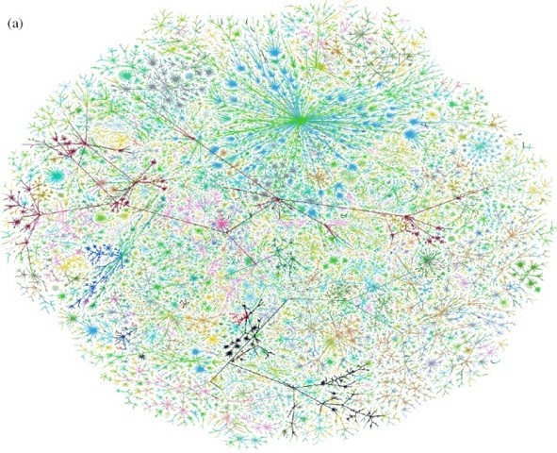
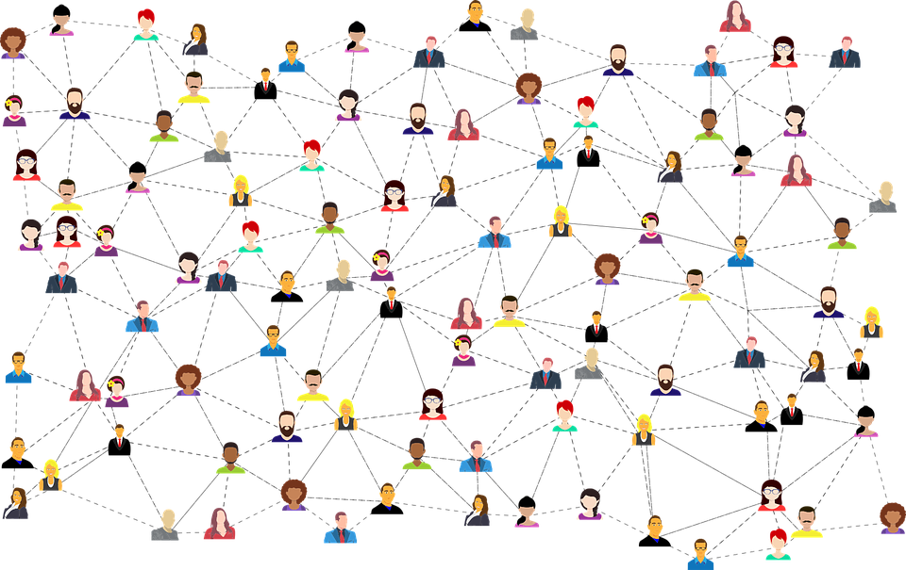
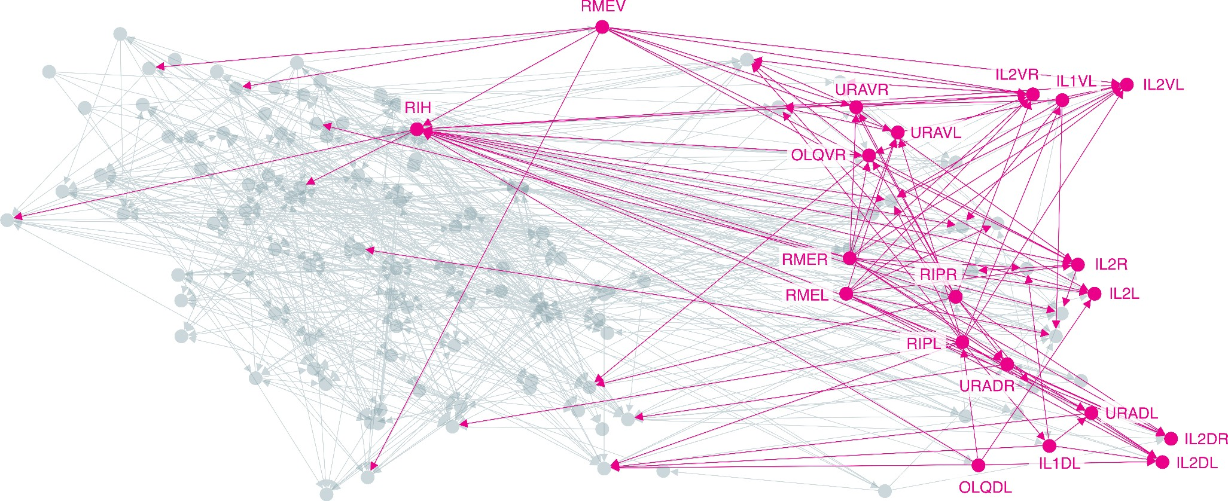
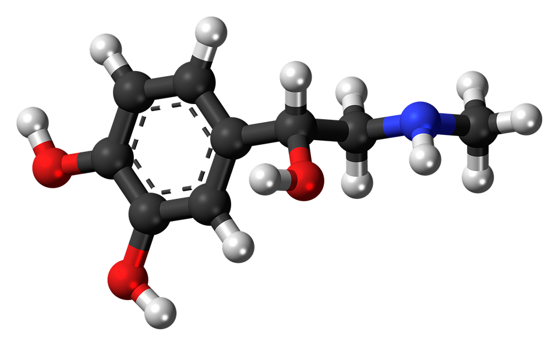
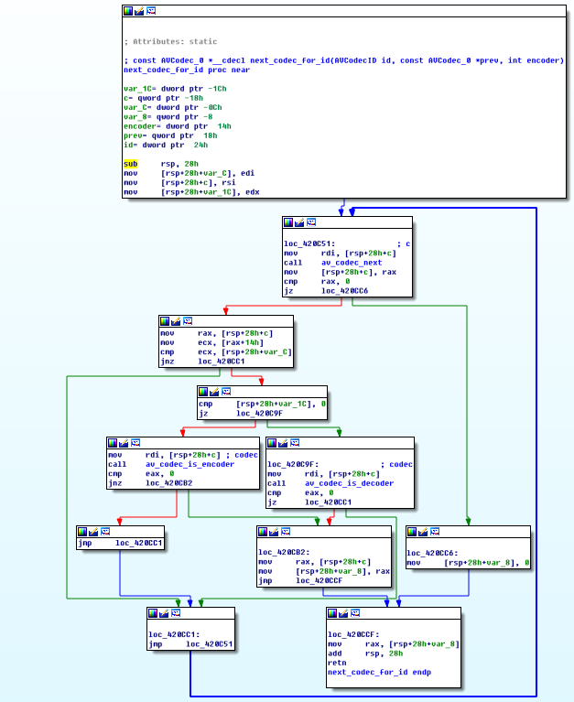
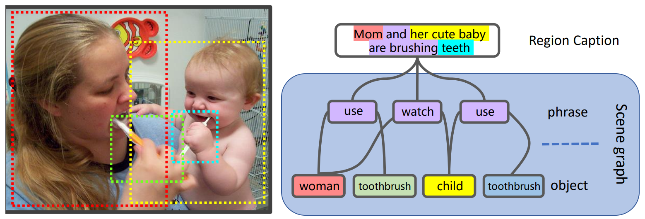
Graph-structured Data Are Ubiquitous
Internet
Social networks
Networks of neurons
Biomedical graphs
Scene graphs
Program graphs

Slide 3
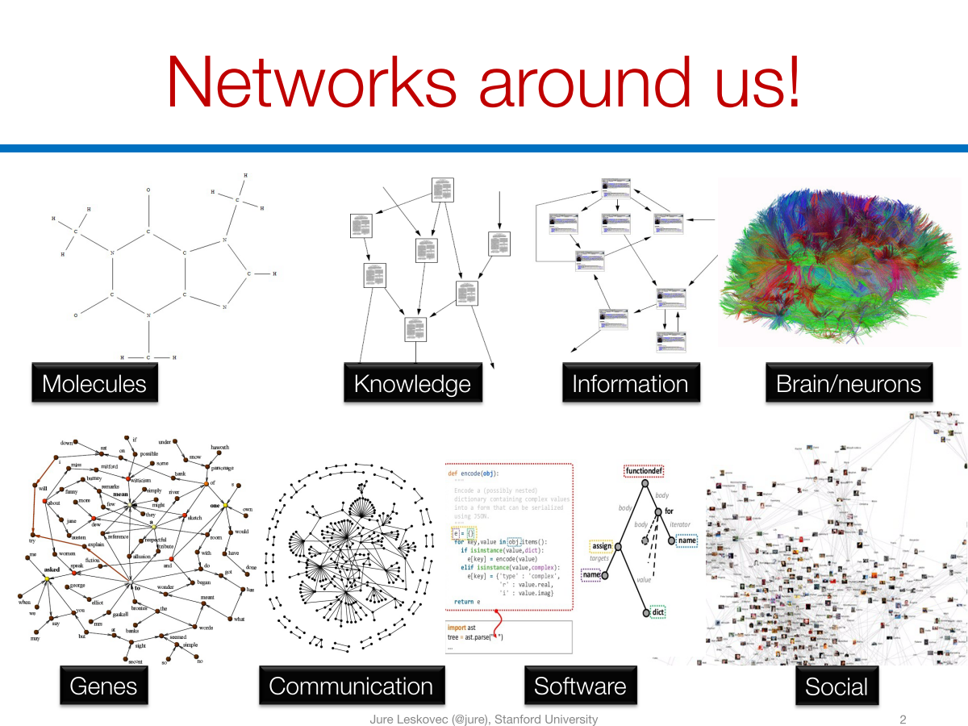

Slide 4
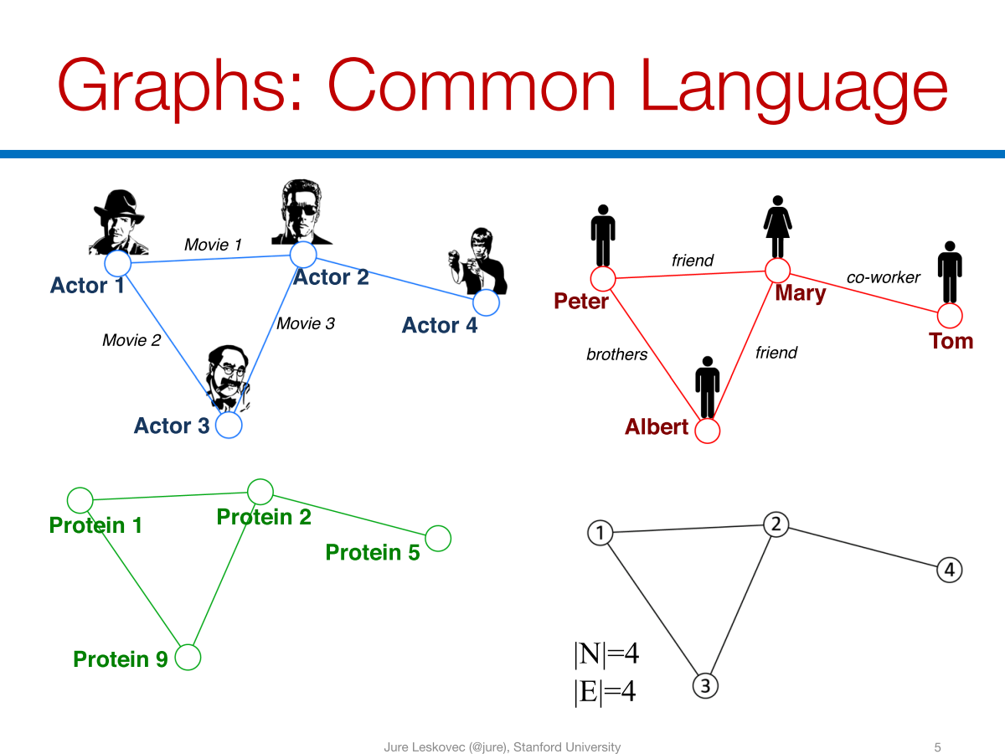

Slide 5
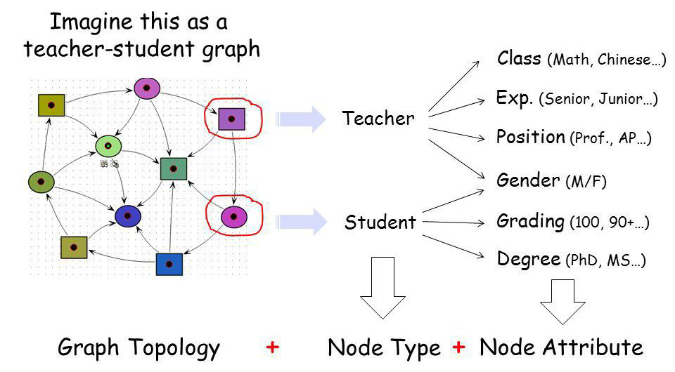
Graphs: A Universal Language
Graphs are a general language for describing and modeling complex systems
Graph!

Slide 6
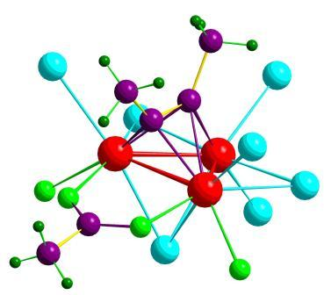
Data as Graphs - Explicit
Social Graphs
Transportation Graphs
Brain Graphs
Web Graphs
Molecular Graphs
Gene Graphs

Slide 7
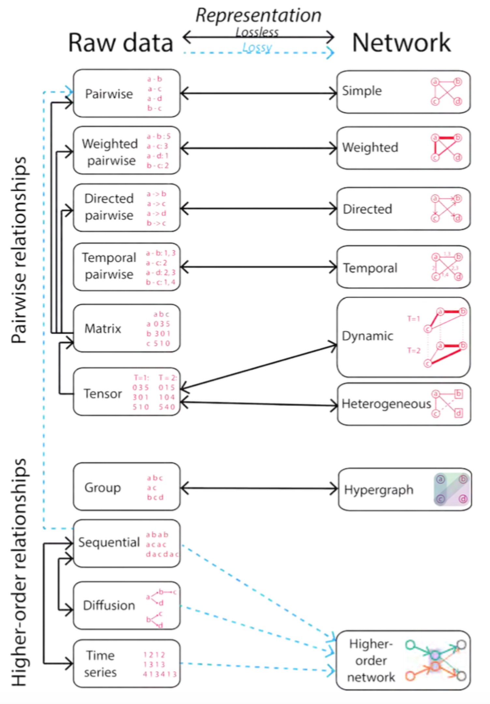

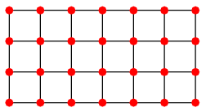
Data as Graphs - Implicit
Jian Xu. Representing Big Data as Networks. PhD Dissertation, University of Notre Dame

Slide 8
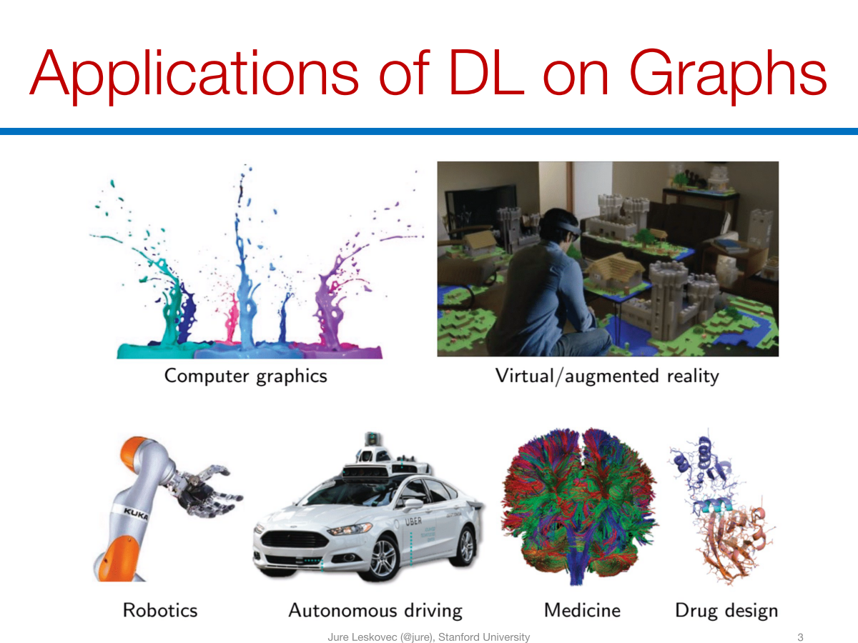

Slide 9
Why Graphs? Why Now?
Universal language for describing complex data
Networks/graphs from science, nature, and technology are more similar than one would expect
Shared vocabulary between fields
Computer Science, Social science, Physics, Biology, Economics
Data availability (+ computational challenges)
Social/internet, text, logic, program, bio, health, and medical
Impact
Social networking, Social media, Drug design, Event detection, Natural language processing, Computer vision, and Logic reasoning

Slide 10
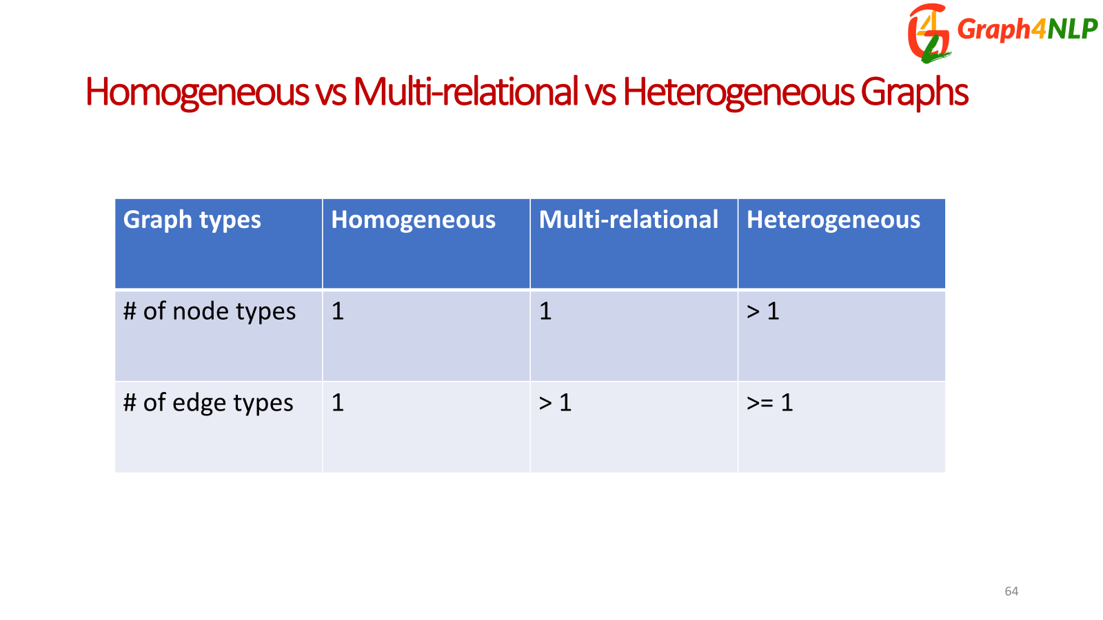

Slide 11
Graphs and features
Graph Signal:

Slide 12
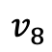

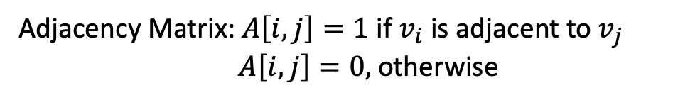
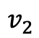
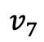
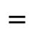
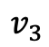
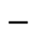
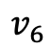
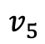

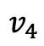
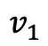

Matrix Representations of Graphs
$$v_{7}$$
$$v_{8}$$
$$v_{1}$$
$$v_{3}$$
Adjacency Matrix: $A\left[i,j\right]=1$ if $v_{i}$ is adjacent to $v_{j}$
$A\left[i,j\right]=0,$ otherwise
$$v_{6}$$
$$v_{5}$$
$$v_{2}$$
Degree Matrix:
$$v_{4}$$
Degree Matrix
Adjacency Matrix
Laplacian Matrix
$$−$$
$$=$$
$$D$$
$$A$$
$$L$$
Spectral graph theory. American Mathematical Soc.; 1997.

Slide 13
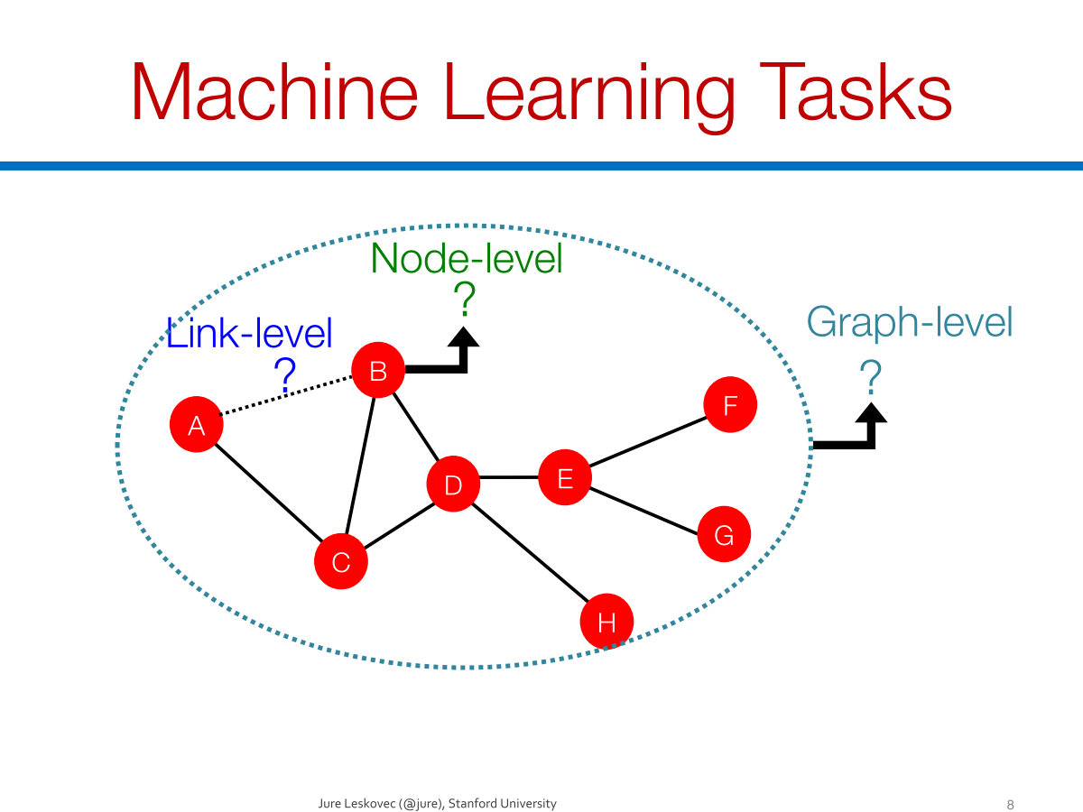

Slide 14
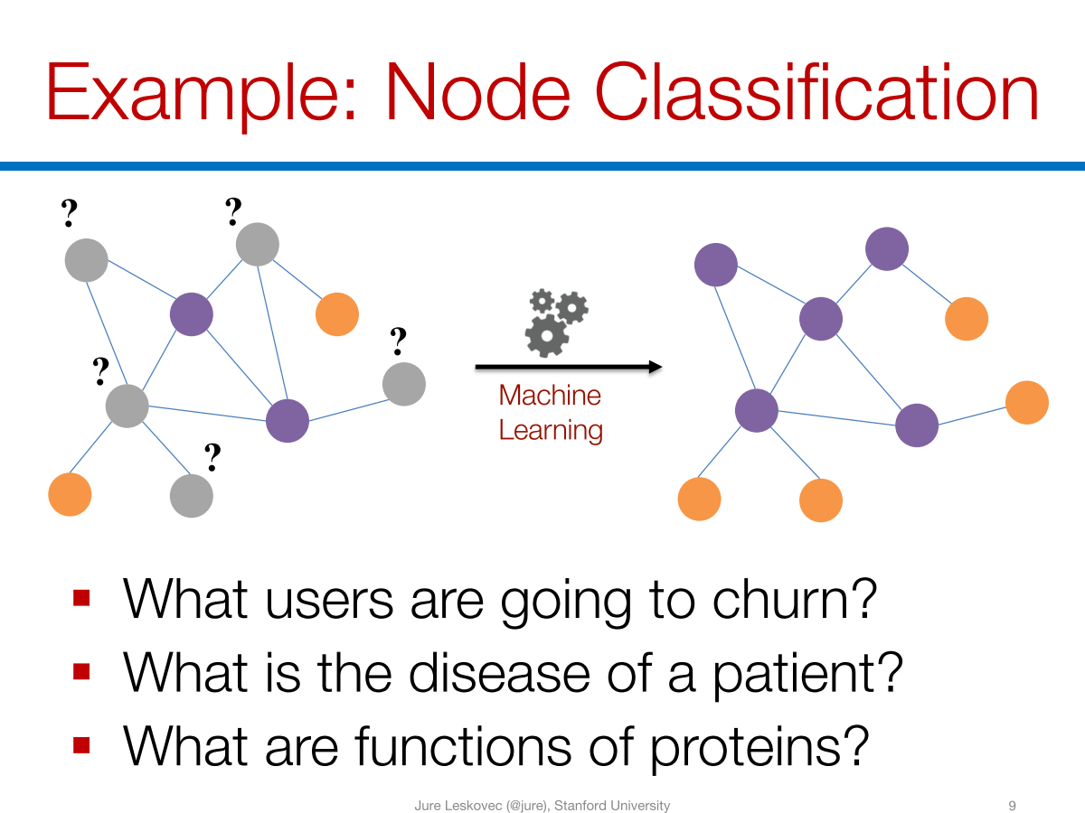

Slide 15
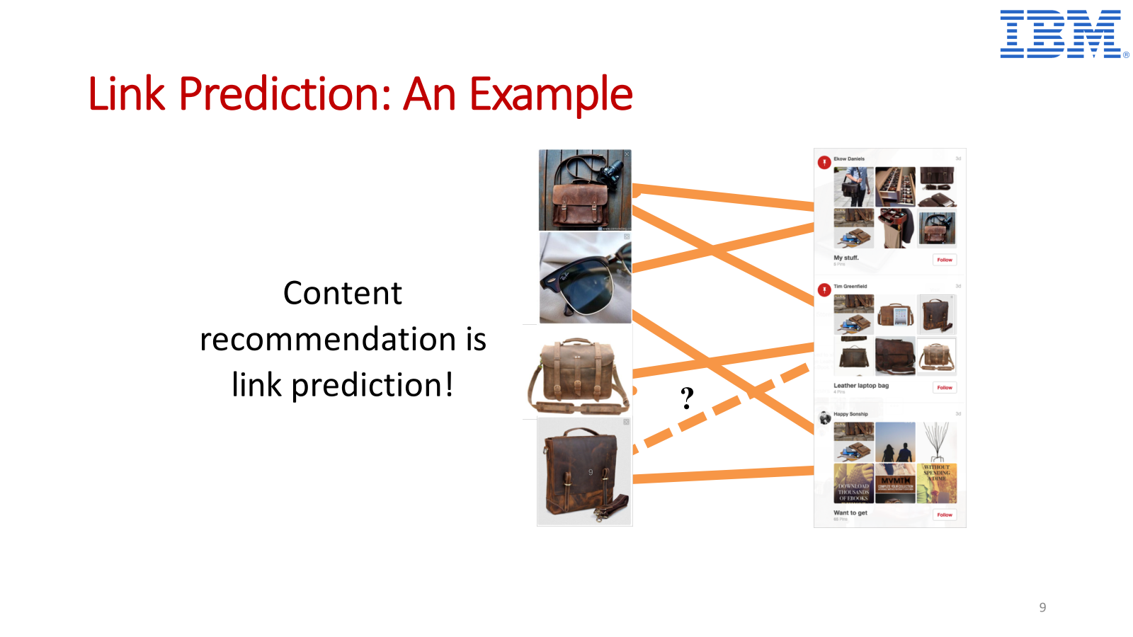

Slide 16
Tasks in graph learning
Node classification
Detect malicious accounts
Target right customers
Link prediction
Recommendations
Predict missing relations in a knowledge graph
Graph classification
Predict the property of a chemical compound

Slide 17
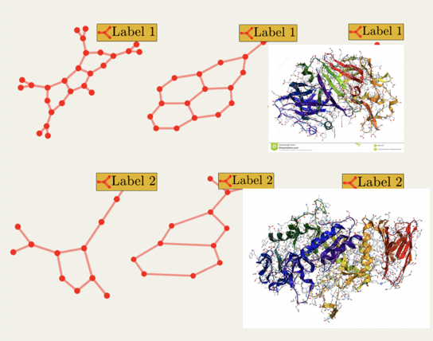
Tasks on Graph-Structured Data
Node-level
Graph-level
Link Prediction
Graph Classification
？
？
t
t+a
Node Classification
？
？
？

Slide 18
ML on Graphs
Numerous real-world problems can be summarized as a set of tasks on graphs
Link prediction
Node Classification
Community Detection
Ranking ….
ML solutions
Classification
Clustering
Traditional
i.i.d. data
Graphs
…..
Feature/Representation
Ranking
Notes:
Implicit → graph (image)
lattice graph
Feature/representation learning is the key. Not necessary can achieve the performance as traditional methods

Slide 19
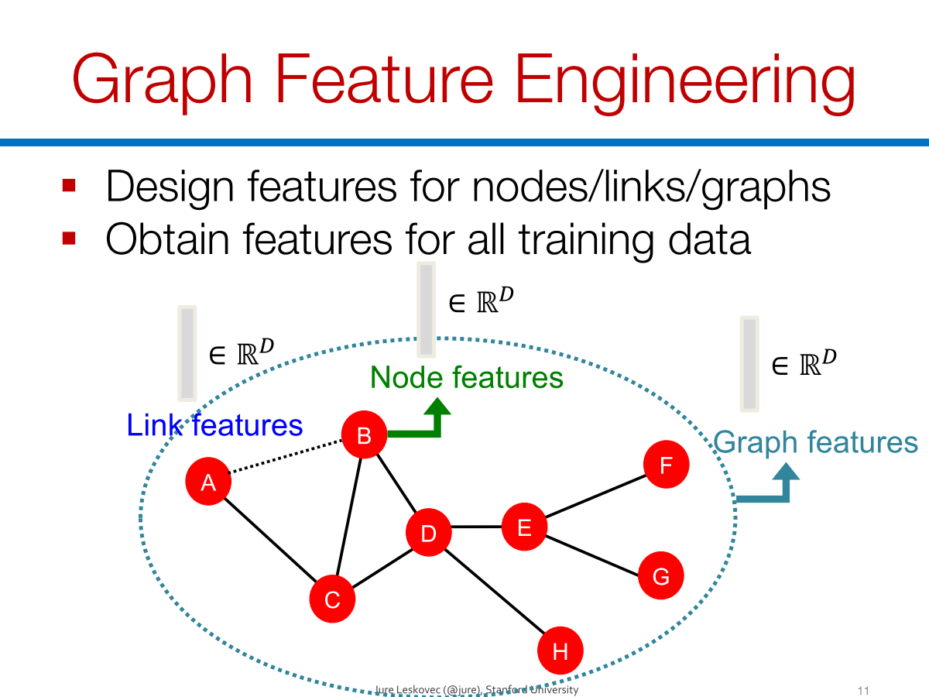

Slide 20
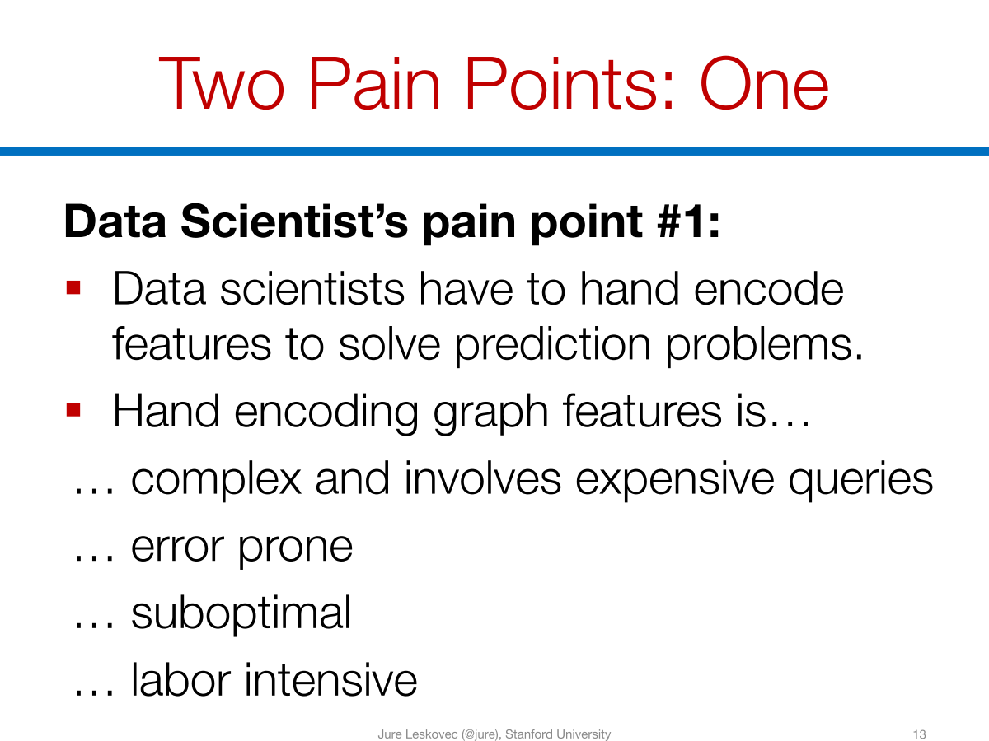

Slide 21
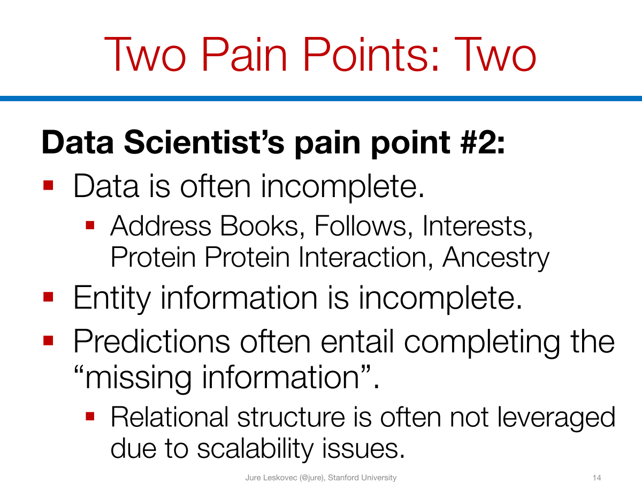

Slide 22
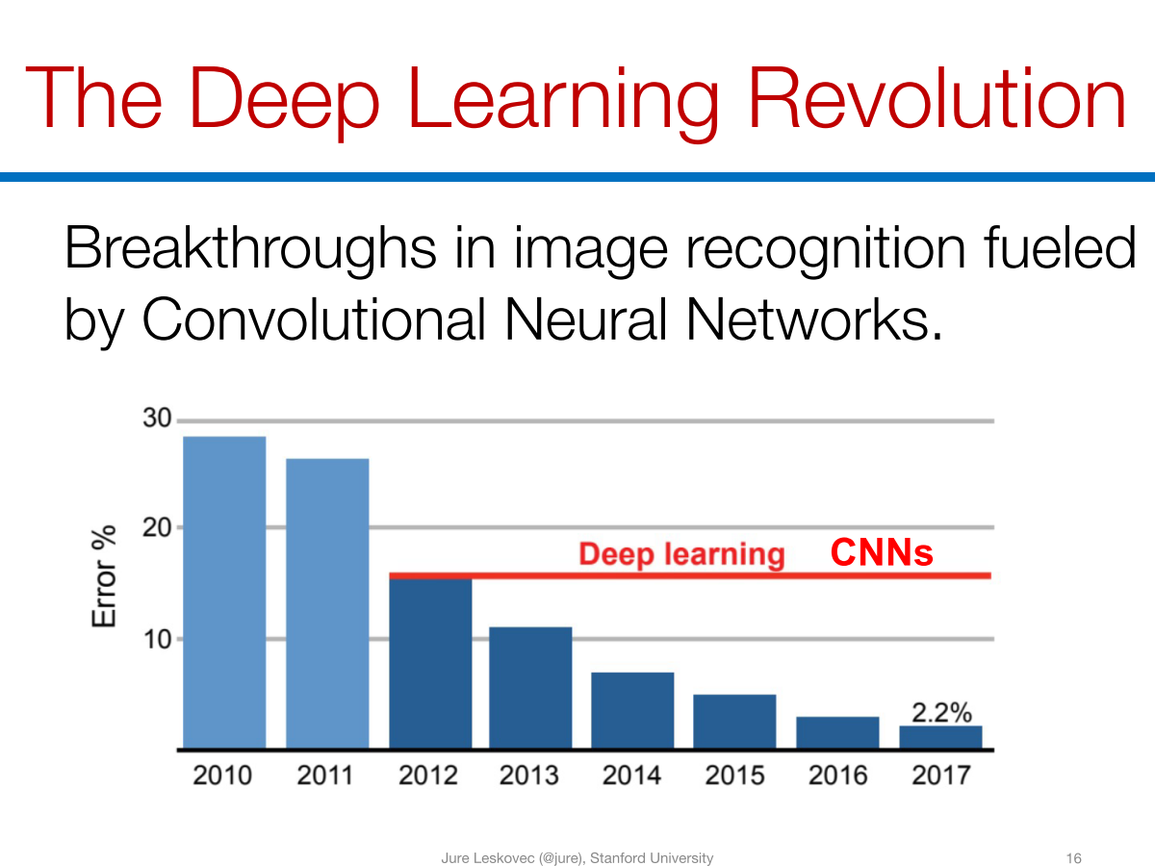

Slide 23
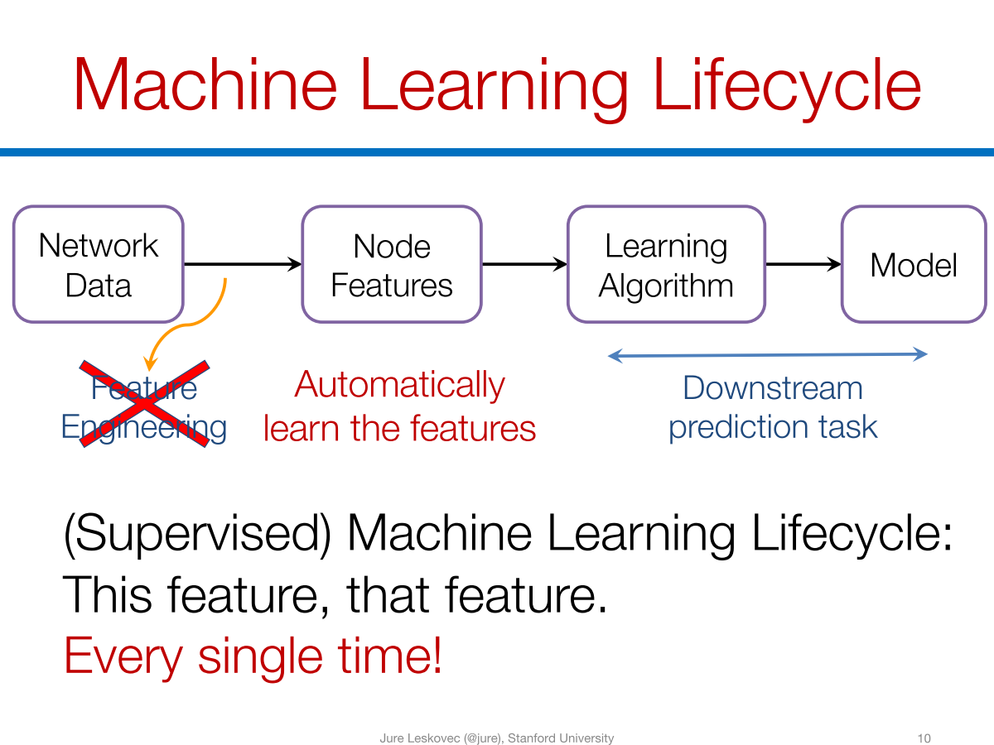

Slide 24
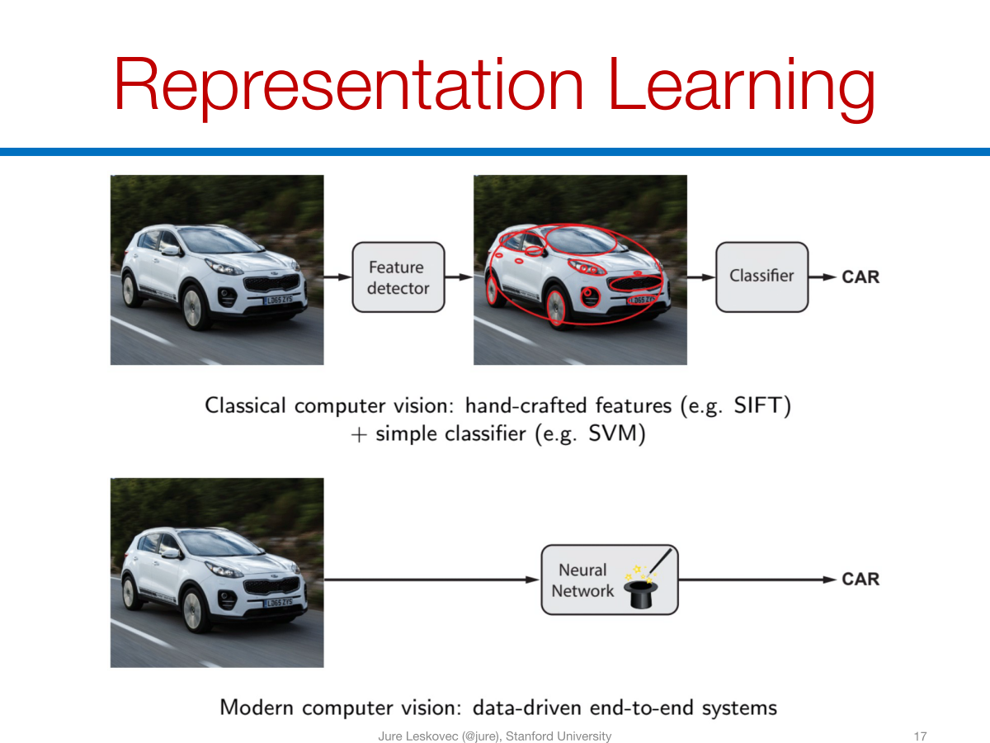

Slide 25
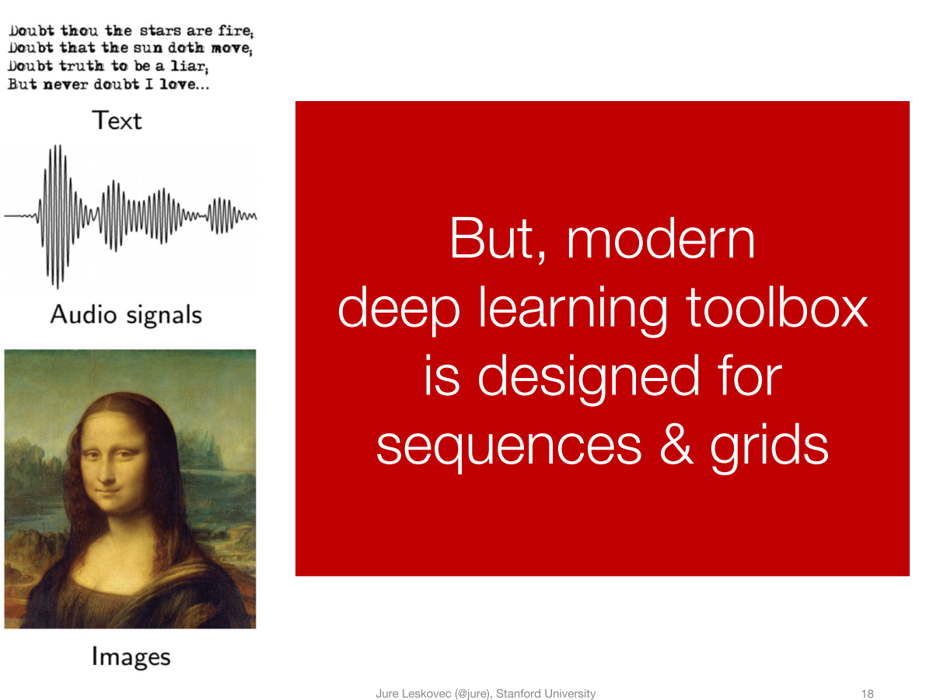

Slide 26
Deep Learning Meets Graphs: Challenges
Traditional DL is designed for simple grids or sequences
CNNs for fixed-size images/grids
RNNs for text/sequences
But nodes on graphs have different connections
Arbitrary neighbor size
Complex topological structure
No fixed node ordering

Slide 27
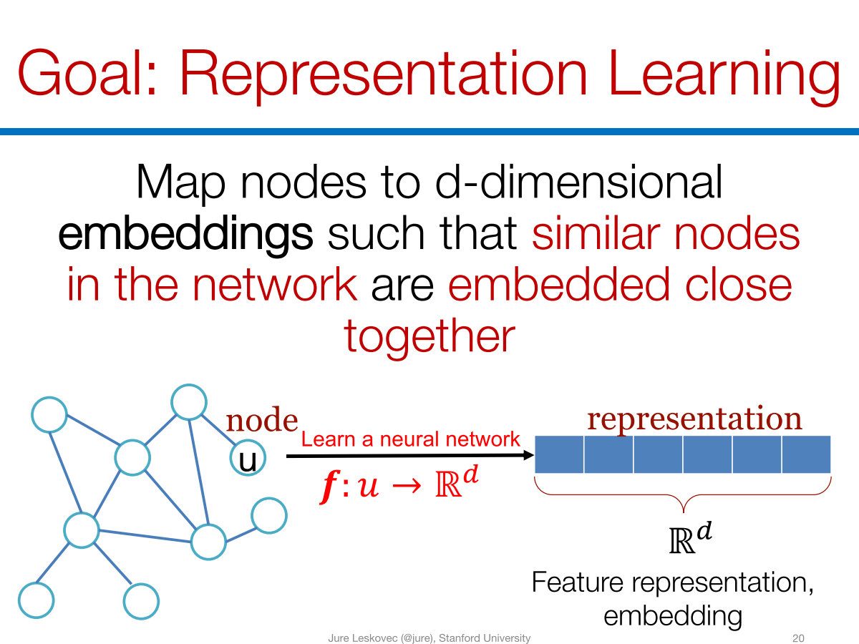

Slide 28

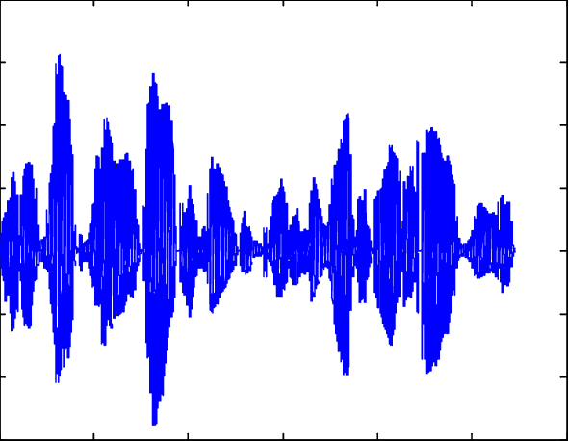
The Power of Deep Learning

Slide 29
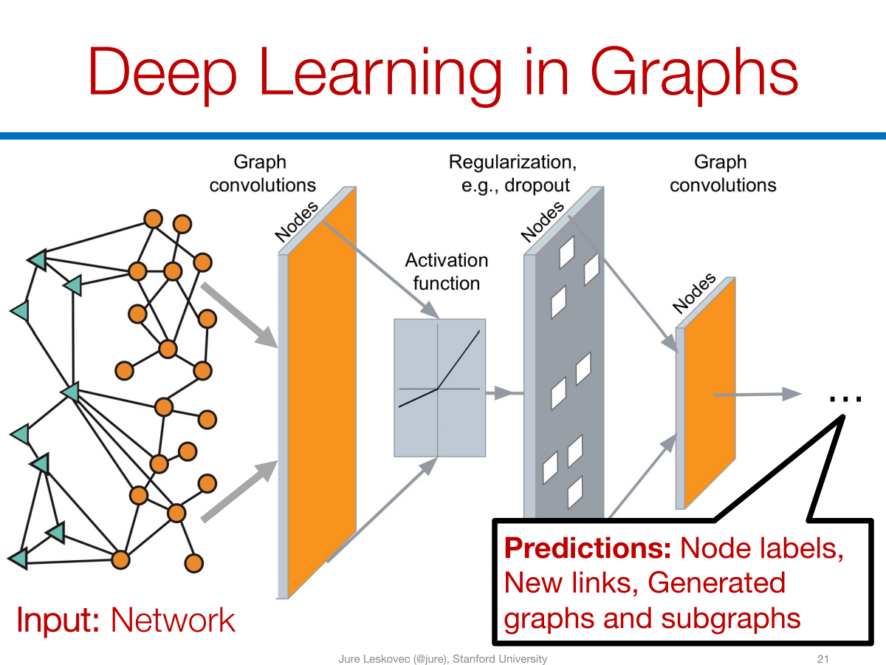

Slide 30
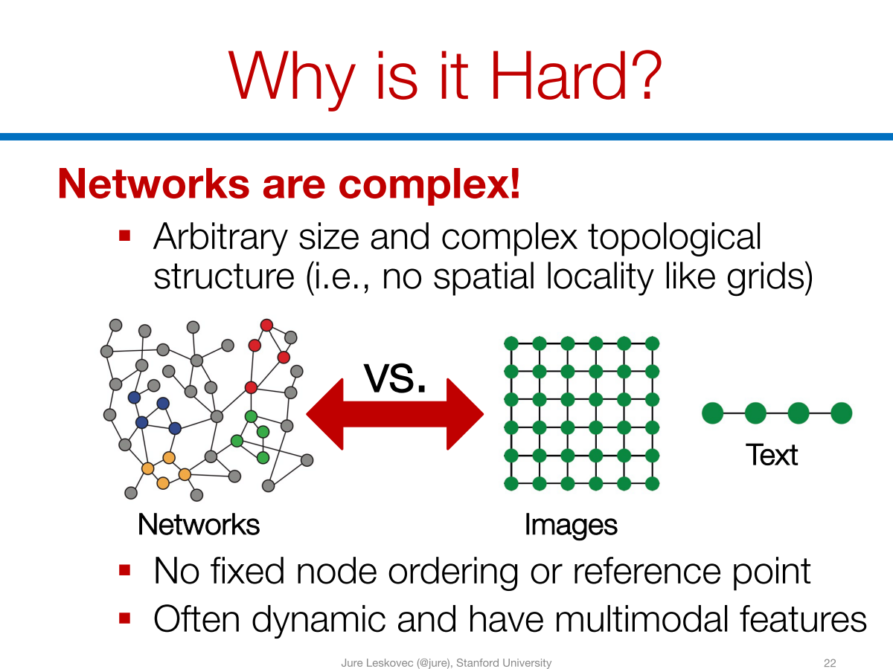

Slide 31
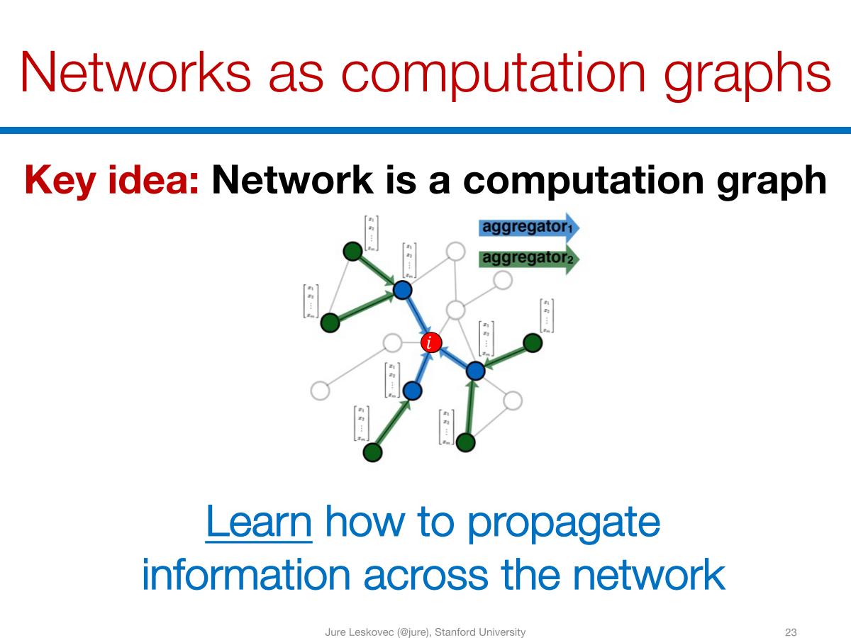

Slide 32

Graph Neural Networks
Representations
Graph-level
Activation Function
Node-level
Graph Convolutions
Graph Convolutions

Slide 33

Machine(Deep) Learning with Graphs
Classical ML tasks in graphs:
Node classification
Predict a type of a given node
Link prediction
Predict whether two nodes are linked
Community detection
Identify densely linked clusters of nodes
Graph similarity
How similar are two (sub)graphs
Recent ML tasks in graphs:
Graph classification
Predict a type of a given graph
Graph generation
Generate graphs from learned distribution
Graph structure learning
Identify densely linked clusters of nodes
Graph-to-XXX learning
Graph Inputs – XXX outputs

Slide 34
Graph Representation Learning (GNNs)
Graph Neural Networks (GNNs) extends the well known CNN and RNN on graphs, from Euclidean data to Graphs and Manifolds
RNN-based GNNs:
Graph neural networks (Scarselli et al., 2009)
Gated graph sequence neural networks (GGS-NNs) (Li et al., ICLR 2016)
CNN-based GNNs:
Graph Convolutional Networks (GCN) (Kipf & Welling, ICLR 2017)
Message Passing-based GNNs:
GraphSAGE (Hamilton & Ying & Leskovec, NIPS 2017)
Graph Attention Networks (GAT) (Velickovic et al., ICLR 2018)
MPNN (Gilmer et al., ICML 2017)

Slide 35
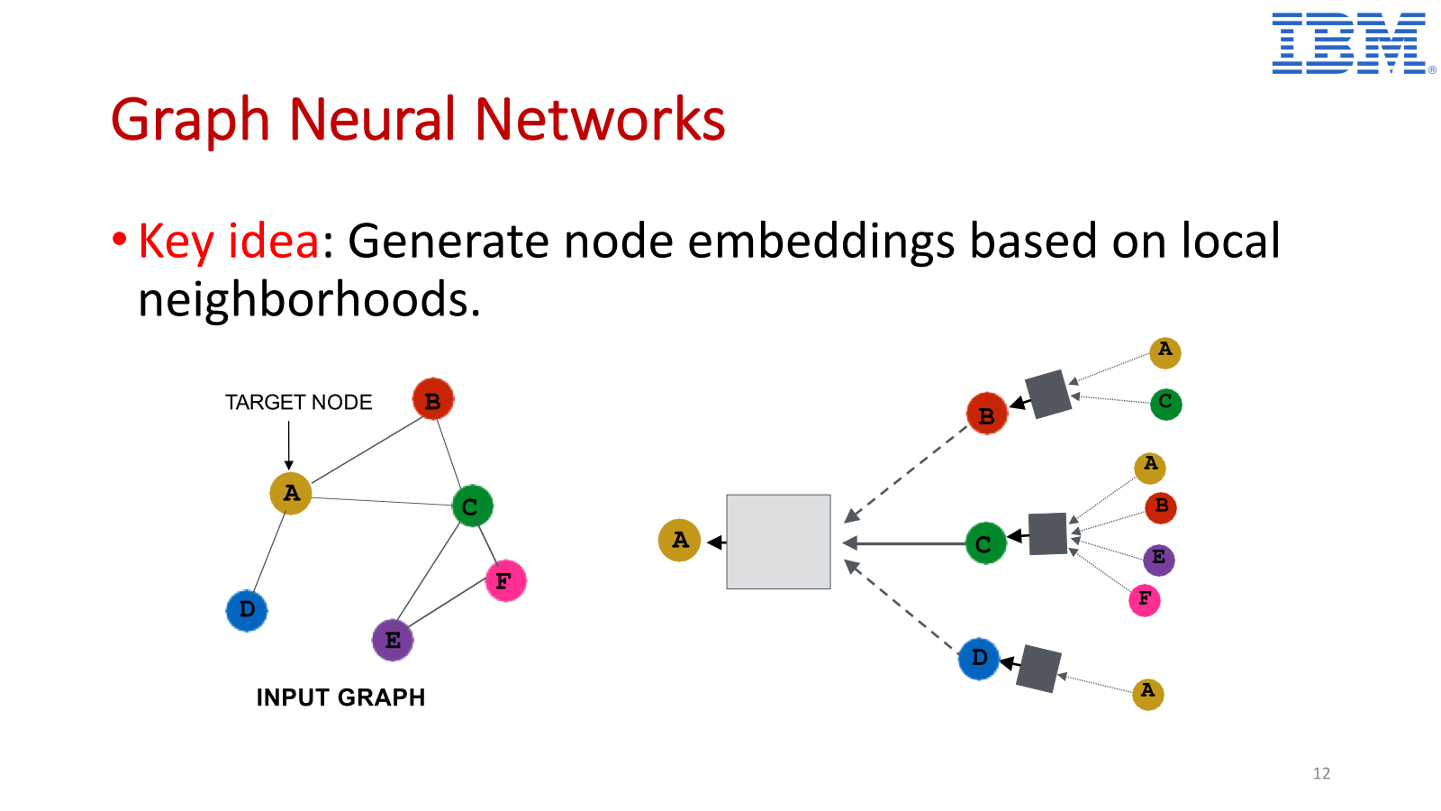

Slide 36
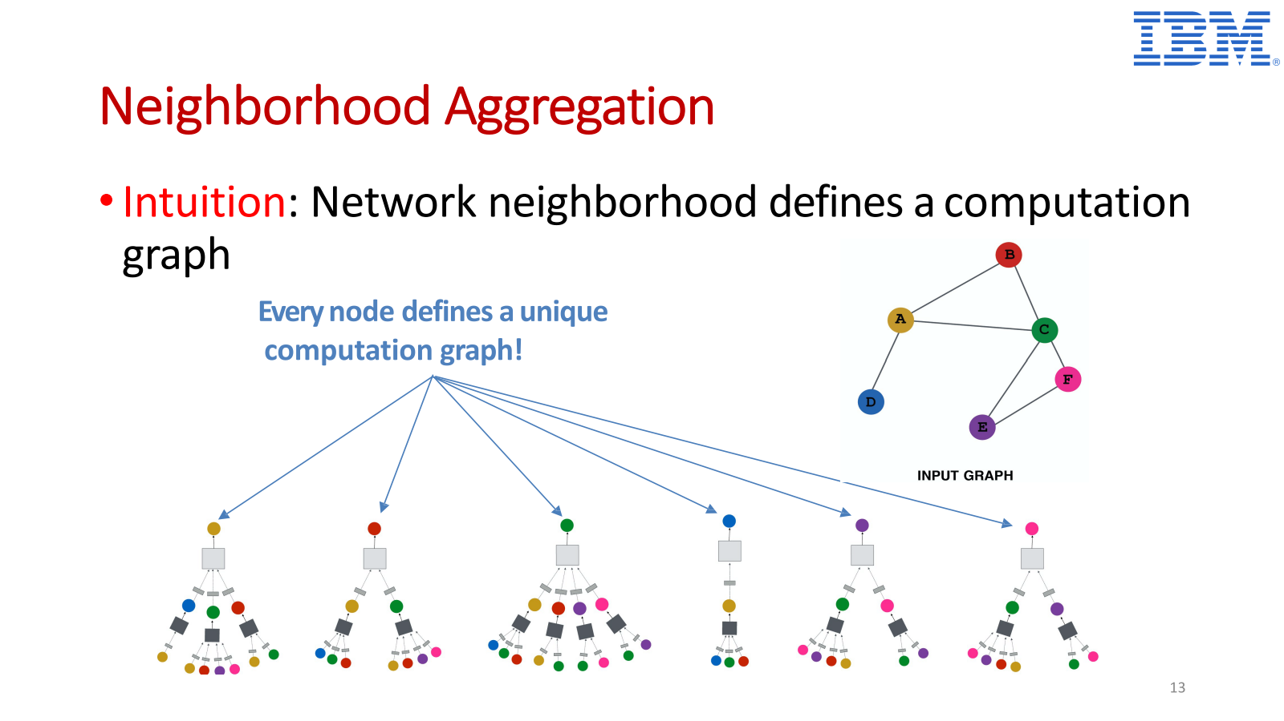

Slide 37
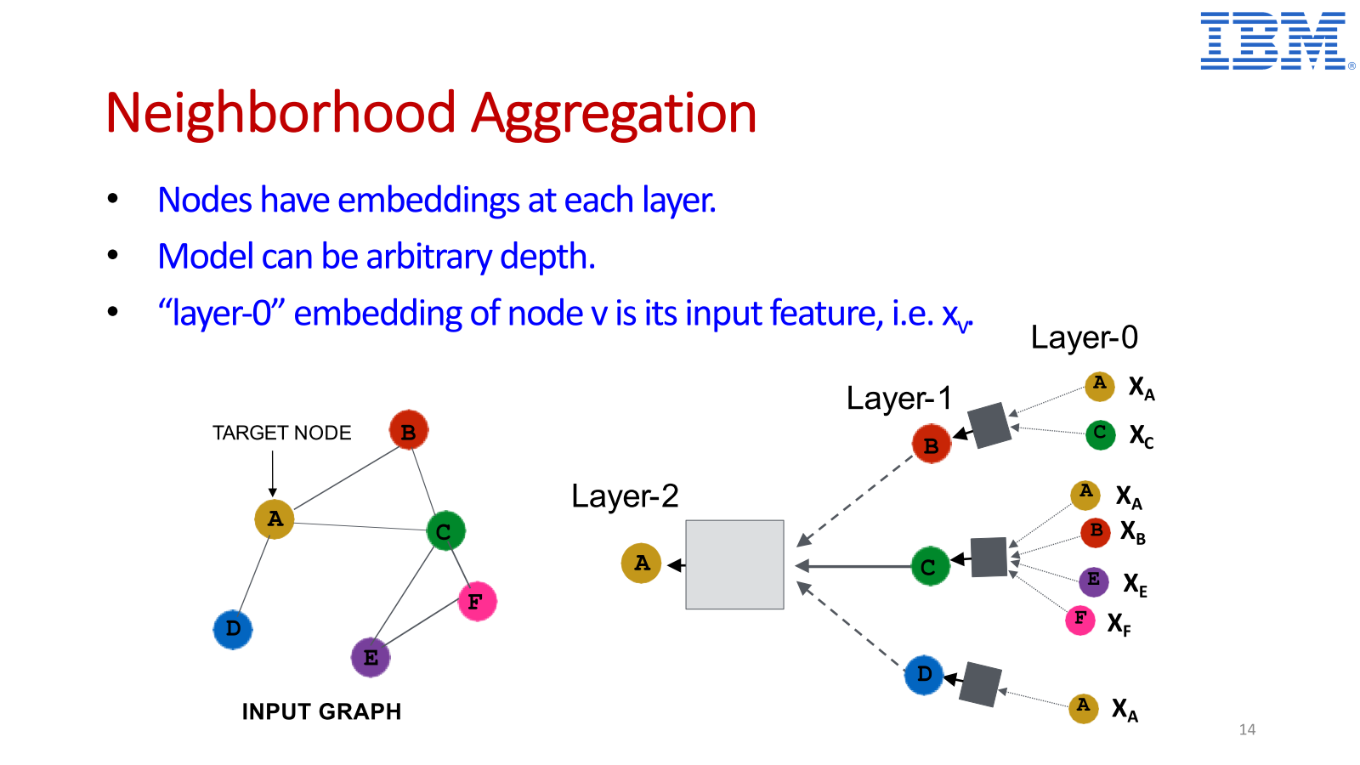

Slide 38
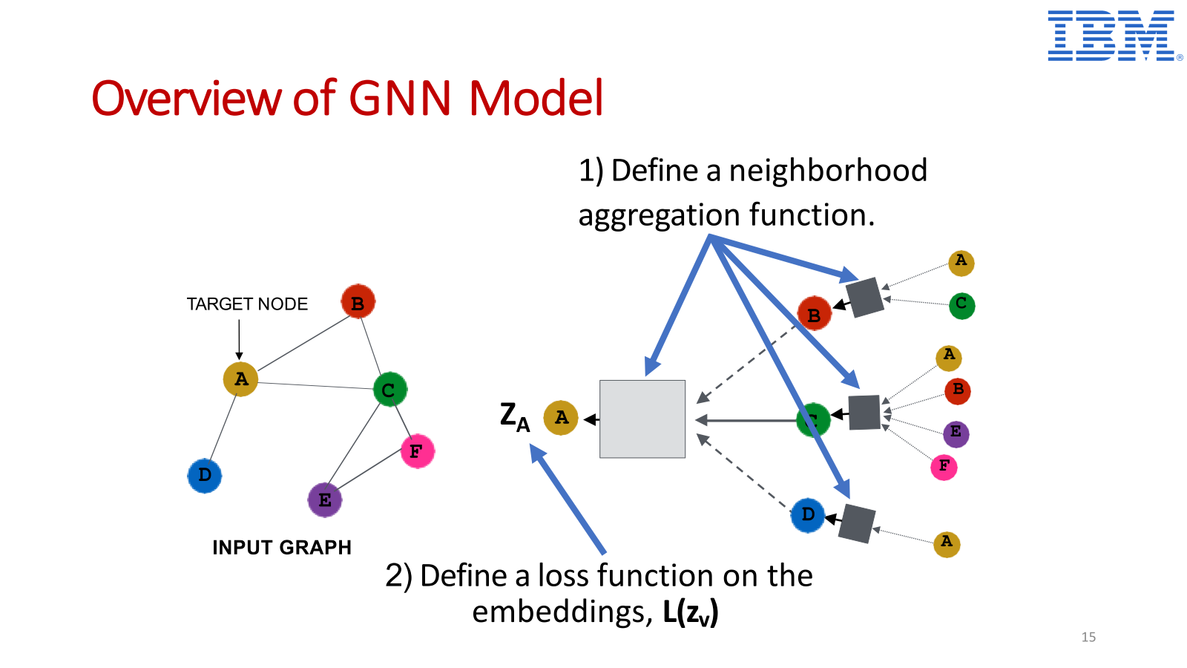

Slide 39
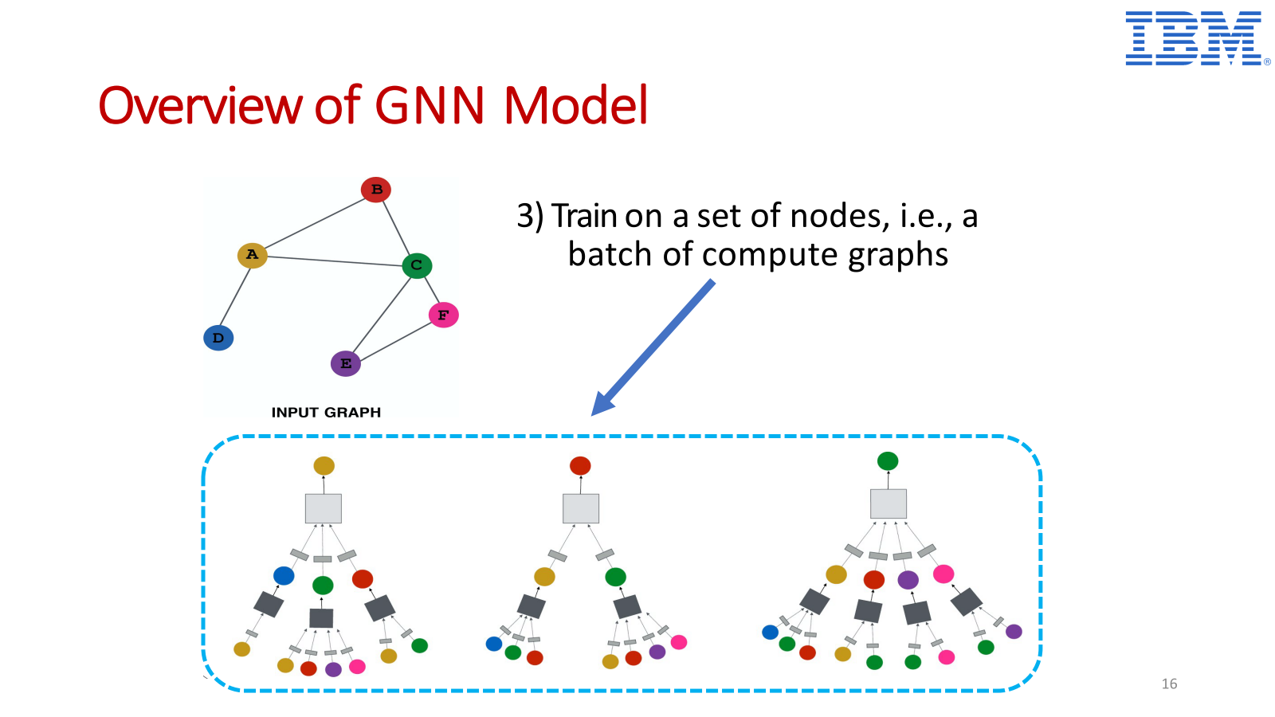

Slide 40
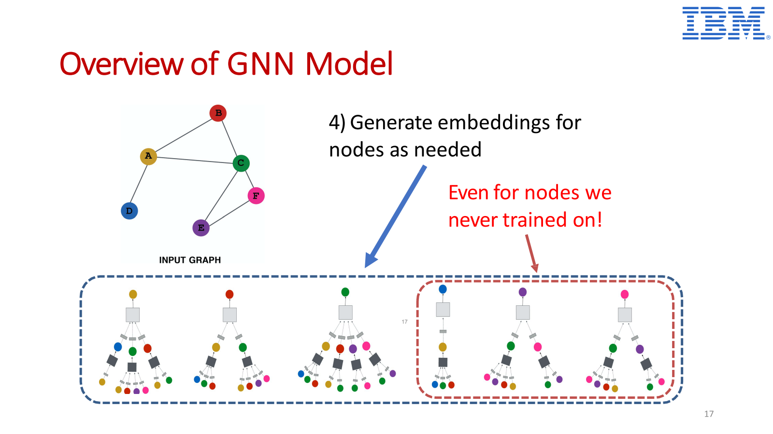

Slide 41
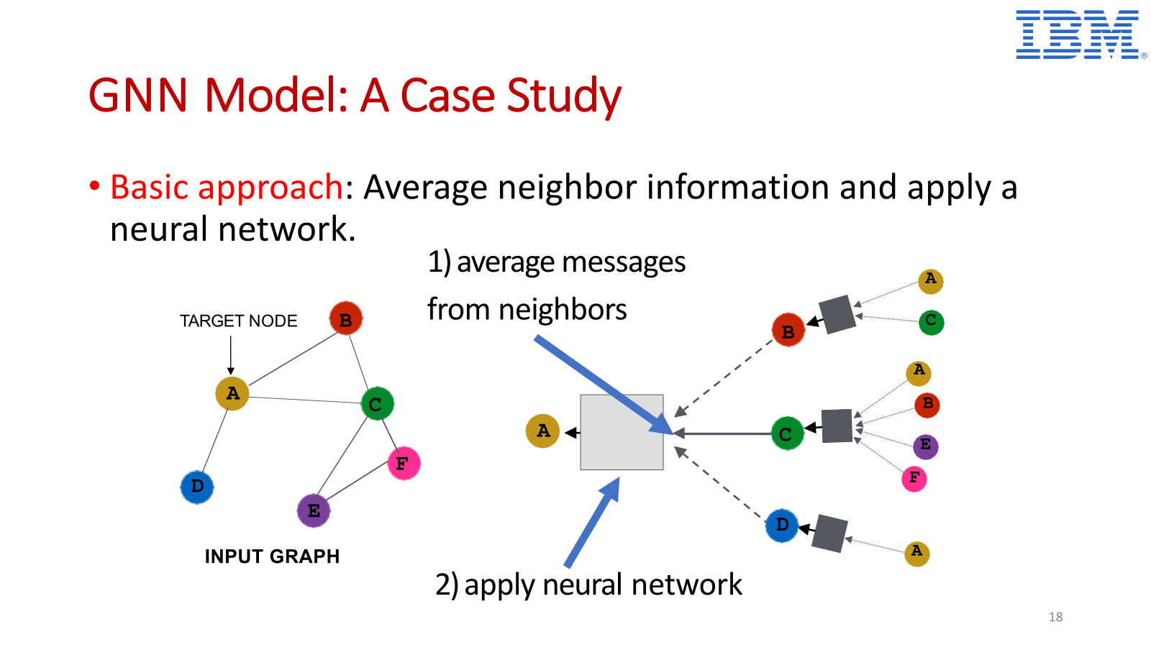

Slide 42
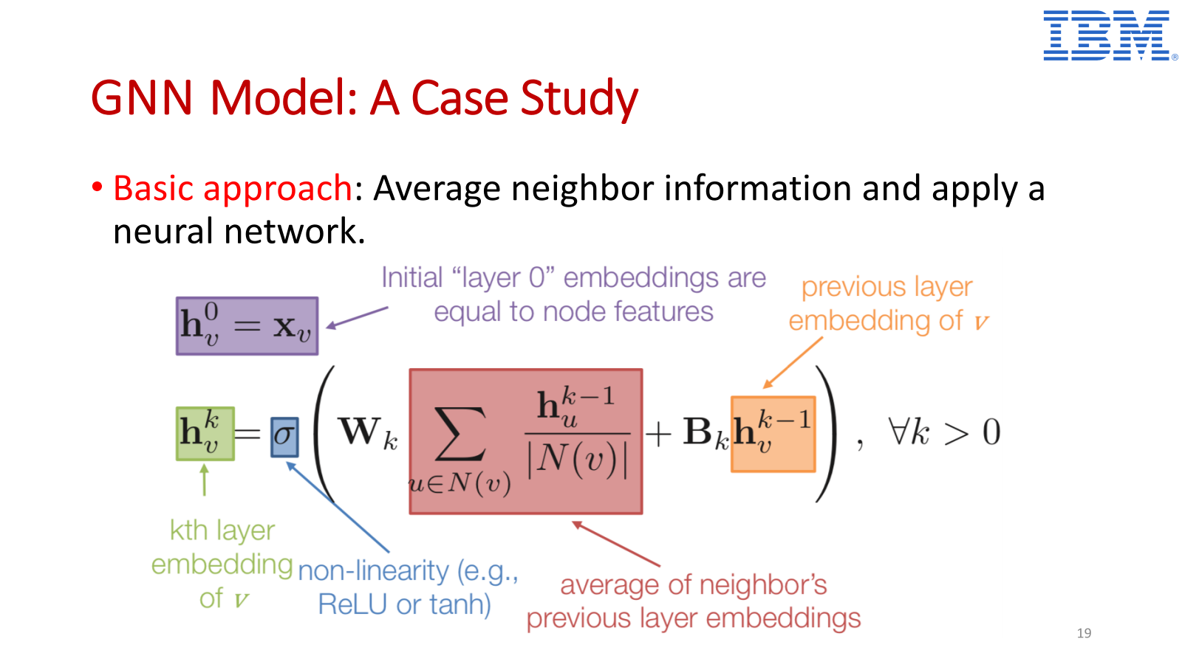

Slide 43
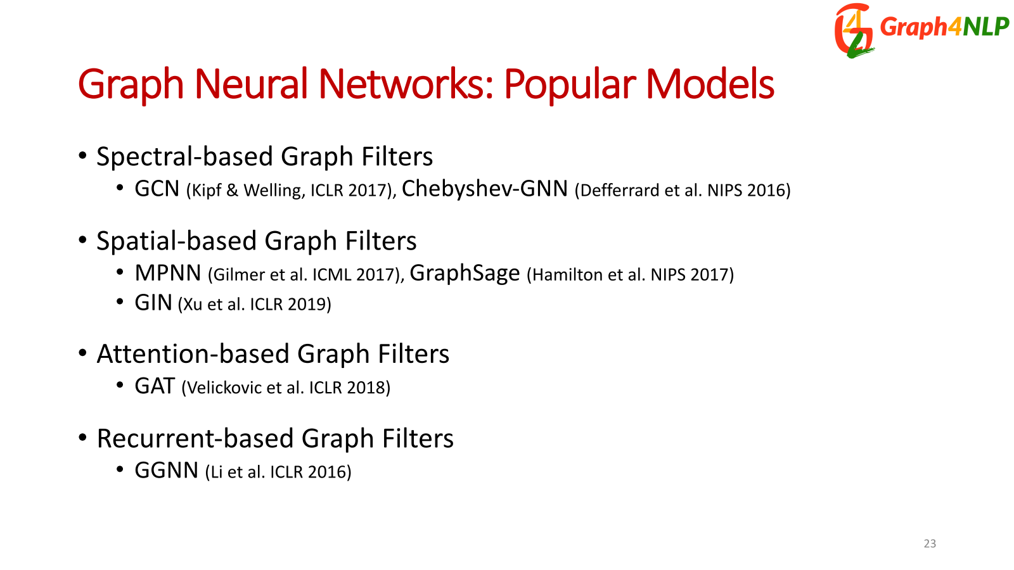

Slide 44



Example 1: Graph convolution network (GCN)
$M_{vw}^{(l)}$= $\frac{h_{w}^{\left(l−1\right)}}{d_{v}+1}$
$$m_{v}^{(l)}=\sum_{w∈N\left(v\right)∪\{v\}}{M_{vw}^{\left(l\right)}}$$
$$h_{v}^{(l)}=φ(m_{v}^{\left(l\right)}W^{(l)})$$

Slide 45





Example 2: Graph attention networks (GAT)
GAT provides weighted sum over the neighborhood—Enables to selectively integrate information.
$M_{vw}^{(l)}$= $α_{vw}h_{w}^{\left(l−1\right)}$
$$m_{v}^{(l)}=\sum_{w∈N\left(v\right)∪\{v\}}{M_{vw}^{\left(l\right)}}$$
$$h_{v}^{(l)}=φ(m_{v}^{\left(l\right)}W^{(l)})$$
$$α_{vw}=\frac{exp⁡(LeakyReLU({\overset{⃑}{a}}^{T}[W{\overset{⃑}{h}}_{v}||W{\overset{⃑}{h}}_{w}]))}{\sum_{k∈N_{v}}{exp⁡(LeakyReLU({\overset{⃑}{a}}^{T}[W{\overset{⃑}{h}}_{v}||W{\overset{⃑}{h}}_{k}]))}}$$

Slide 46





Example 3: Relational graph convolution networks (RGCN)
Handles graphs whose nodes are connected with different relations.
$M_{vw}^{(l)}$= $\frac{1}{c_{v,r}}W_{r}^{(l)}h_{w}^{\left(l−1\right)}$, r is the relation of $e_{vw}$.
$$m_{v}^{(l)}=\sum_{w∈N\left(v\right)∪\{v\}}{M_{vw}^{\left(l\right)}}$$
$$h_{v}^{(l)}=σ(m_{v}^{\left(l\right)}W^{(l)})$$

Slide 47

Source: Graph Neural Networks: A Review of
Methods and Applications

Slide 48


Slide 49


Slide 50

Why are graph neural networks better?
GNNs compute node embeddings using both the structure of the graph and the features of the nodes and edges.
Name: xxx
Age: xxx
Sex: xxx
Title: How to lie with statistics
Author: Darrell Huff
Type: Kindle Edition
Price: $6.91
users
books

Slide 51



Why are graph neural networks better?
GNNs can integrate topologically distant information in a non-linear fashion.
1st layer
2nd layer

Slide 52
Why are graph neural networks better?
GNNs and the downstream classification/regression models can be trained in an end-to-end fashion.
Traditional method
Classifier
GNN
Classifier

Slide 53
Why are graph neural networks better?
GNNs are naturally inductive because they learn the same neural networks on all the nodes and edges.
GNN
GNN

Slide 54
Summary
The solution to many applications can be formulated as graph learning problems.
Graph neural networks are a new technique for graph learning.
They have multiple advantages over traditional methods.
GNNs are used in multiple graph tasks and can be trained end-to-end.

Slide 55
References (Slides primarily borrowed from…)
Overview of Graph Neural Networks - George Karypis
Graph Neural Networks: Models and Applications - Yao Ma, et al
GraphSAGE: Deep Learning for Relational Data - Jure Leskovec
Deep Learning on Graphs in Natural Language Processing and Computer Vision - Lingfei Wu, IBM Research AI
Deep Learning on Graphs for Natural Language Processing - Lingfei Wu, Yu Chen, Heng Ji, and Yunyao Li, NAACL-2021 Tutorial

